Slide 1
JPEG Compression
Nancy Victor
Assistant Professor
SITE, VIT University

Slide 2
Image Compression Standard
Reduce the amount of data required to represent a digital image.
This can be achieved by removing redundant data.
Redundancies:
Coding Redundancy: Gray levels of the image uses more number of bits than that is actually necessary.
Inter-pixel redundancy: Results from structural or geometric relationship between objects in an image.
Psycho-visual redundancy: Our eyes do not respond to all visual information.

Slide 3
JPEG Compression
JPEG stands for Joint Photographic Experts Group
Used on 24-bit color files.
Works well on photographic images.
Although it is a lossy compression technique, it yields an excellent quality image with high compression rates.

Slide 4
Steps in JPEG Compression
1. If the color is represented in RGB mode, translate it to YUV.
2. Divide the file into 8 X 8 blocks.
3. Transform the pixel information from the spatial domain to the frequency domain with the Discrete Cosine Transform.
4. Quantize the resulting values by dividing each coefficient by an integer value and rounding off to the nearest integer.
5. Look at the resulting coefficients in a zigzag order. Do a run-length encoding of the coefficients ordered in this manner. Follow by Huffman coding.

Slide 5
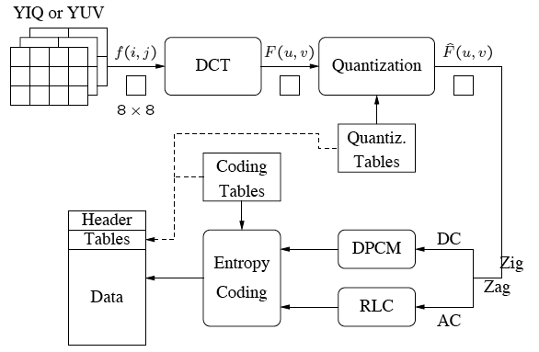
JPEG Encoding Overview

Slide 6
Step 1a: Converting RGB to YUV
YUV color mode stores color in terms of its luminance (brightness) and chrominance (hue).
The human eye is less sensitive to chrominance than luminance.
YUV is not required for JPEG compression, but it gives a better compression rate.

Slide 7
RGB vs. YUV
The formula is based on the relative contributions that red, green, and blue make to the luminance and chrominance factors.
There are several different formulas in use depending on the target monitor. For example:
Y = 0.299 * R + 0.587 * G + 0.114 * B
U = -0.1687 * R – 0.3313* G + 0.5 * B + 128
V = 0.5 * R – 0.4187 * G – 0.813 * B + 128

Slide 8
Step 1b: Downsampling
The chrominance information can (optionally) be downsampled.
The notation 4:1:1 means that for each block of four pixels, you have 4 samples of luminance information (Y), and 1 each of the two chrominance components (U and V). MCU – minimum coded unit
Y
Y
U, V
Y
Y

Slide 9
Step 2: Divide into 8 X 8 blocks
The pixels are level shifted by 2^{n-1}, where 2^{n} is the maximum gray level.
If it is 8x8 block of pixels, the level shift will be equal to 2⁸⁻¹, i.e. 2⁷=128.

Slide 10
Step 3: Discrete Cosine Transform
The DCT transforms the data from the spatial domain to the frequency domain.
The spatial domain shows the amplitude of the color as you move through space.
The frequency domain shows how quickly the amplitude of the color is changing from one pixel to the next in an image file.

Slide 11
Step 3: Forward DCT
For an N X N pixel image
the DCT is an array of coefficients
where
where

Slide 12
Step 4: Quantize the Coefficients Computed by the DCT
After DCT, the first value will be DC co-efficient, which is the average of all values and all the other values are AC co-efficient.
Quantization involves dividing each coefficient by an integer between 1 and 255 and rounding off.
The quantization table is chosen to reduce the precision of each coefficient to no more than necessary.
Divide the DCT co-efficient by the value in Quantization table.
The quantization table is carried along with the compressed file

Slide 13
Step 5: Arrange in “zigzag” order
Scan all the values in zig-zag manner.
This is done so that the coefficients are in order of increasing frequency.
The higher frequency coefficients are more likely to be 0 after quantization.
This improves the compression of run-length encoding.
Do run-length encoding and Huffman coding.

Slide 14
Entropy Coding
DC co-efficients are difference coded.
Difference between the current DC co-efficient and previously coded sub image DC co-efficient is found out.
And then, Huffman coded by referring DC coded table.
Non-zero AC co-efficients are either Run-length encoded or Huffman coded.

Slide 15
Thank you…

